Slide 1
ShanghaiTech University
EE 115B: Digital Circuits
Fall 2024
Lecture 13
Hengzhao Yang
November 26, 2024

Slide 2
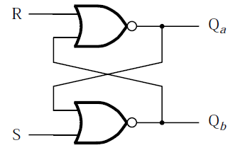

Basic SR latch
Basic SR latch
  Circuit: two cross-coupled NOR gates
  S: set signal
  R: reset signal
  Left to right: circuit and circuit symbol
Source: https://en.wikibooks.org/wiki/Digital_Circuits/Latches

Slide 3

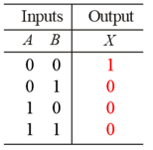
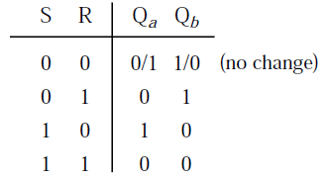
Basic SR latch
Characteristic table
  S=0, R=0: latched/hold/no change
  S=0, R=1: reset (Q_{a}=0, Q_{b}=1)
  S=1, R=0: set (Q_{a}=1, Q_{b}=0)
  S=1, R=1: illegal/not allowed/metastable

Slide 4
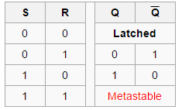
Basic SR latch
Characteristic table (alternate)
S and R are active high signals.
Source: https://en.wikibooks.org/wiki/Digital_Circuits/Latches

Slide 5
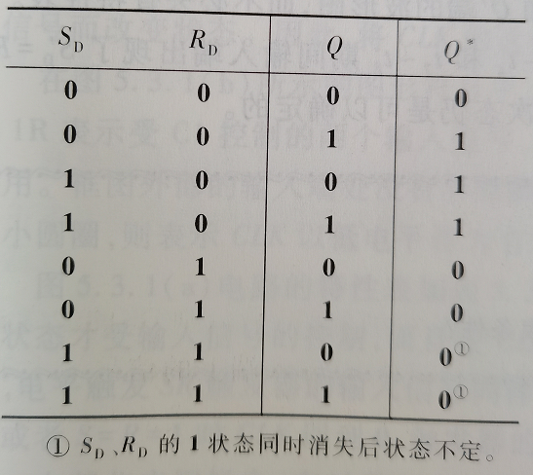
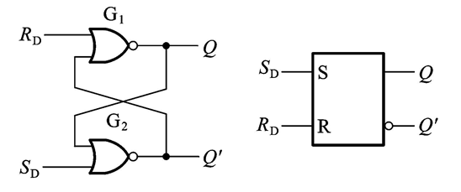
Basic SR latch
Characteristic table (alternate)

Slide 6
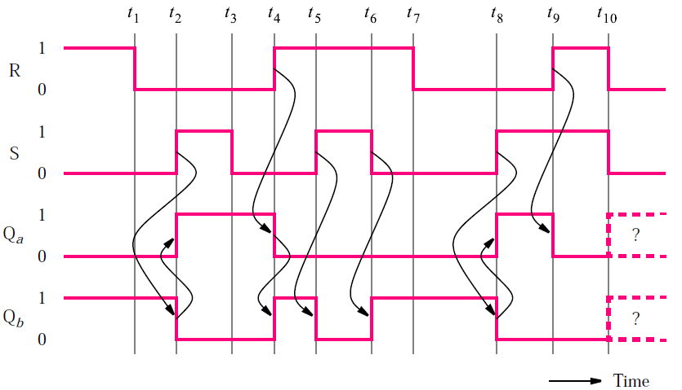
Basic SR latch
Timing diagram (assume no propagation delay)

Slide 7
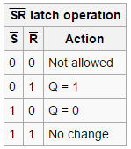
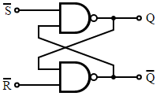

Alternate basic SR latch
Implementation: NAND gates
Set and reset are active low signals.
Left to right: circuit, circuit symbol, and characteristic table
Source: https://en.wikipedia.org/wiki/Flip-flop_(electronics)

